Slide 1
SPARQL
Mauricio Espinoza Mejía
mauricio.espinoza@ucuenca.edu.ec

Slide 2
Content
Main Idea of SPARQL Queries
Components of SPARQL Queries
Graph Patterns
Constraints on Solutions
Components of SPARQL Queries: Other feautures
Solution Modifiers
SPARQL 1.1

Slide 3
SPARQL in General
A family of W3C recommendations
SPARQL Query
Declarative query language for RDF data
SPARQL Update
Declarative update language for RDF data
SPARQL Protocol
Communication between SPARQL processing
services (a.k.a. SPARQL endpoints) and clients
SPARQL Query Results XML Format
XML format for serializing query results

Slide 4
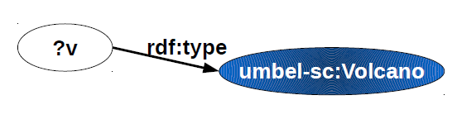
Main Idea of SPARQL Queries
Pattern matching:
Describe subgraphs of the queried RDF graph
Subgraphs that match your description contribute an answer
Mean: graph patterns (i.e. RDF graphs with variables)

Slide 5
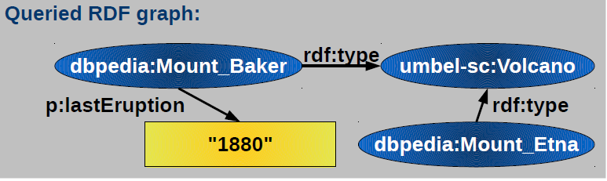
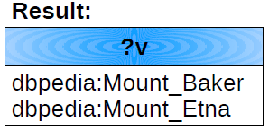
Main Idea of SPARQL Queries

Slide 6
Content
Main Idea of SPARQL Queries
Components of SPARQL Queries
Graph Patterns
Constraints on Solutions
Components of SPARQL Queries: Other feautures
Solution Modifiers
SPARQL 1.1

Slide 7
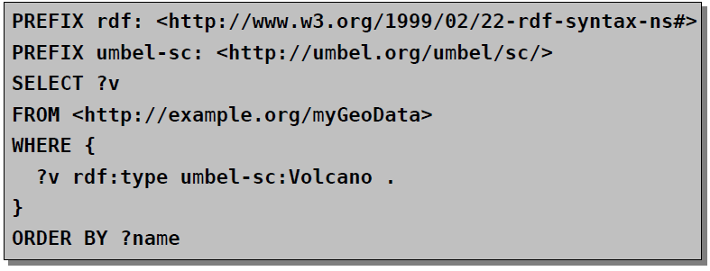
Components of SPARQL Queries

Slide 8
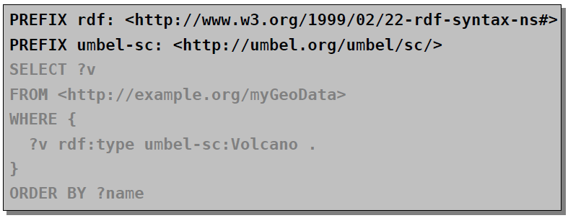
Components of SPARQL Queries
Prologue:
Prefix definitions for using compact URIs
Attention (difference to Turtle): No period (“.”) character as separator

Slide 9
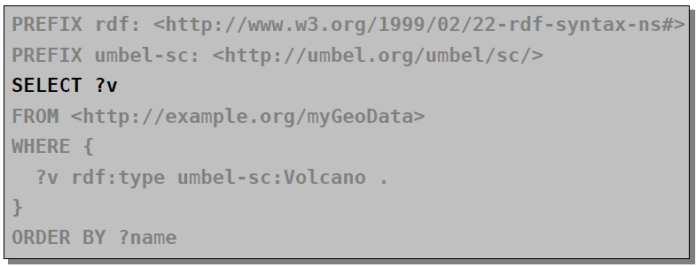
Components of SPARQL Queries
Result form specification:
SELECT, DESCRIBE, CONSTRUCT, or ASK

Slide 10
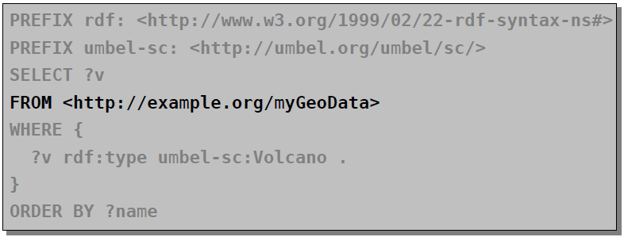
Components of SPARQL Queries
Dataset specification:
Specify the RDF dataset to be queried

Slide 11
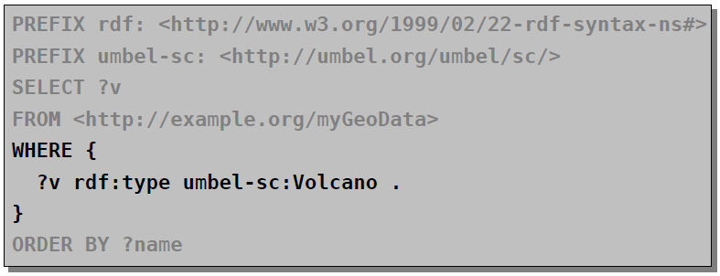
Components of SPARQL Queries
Query Pattern:
WHERE clause specifies the graph pattern to be matched

Slide 12
Content
Main Idea of SPARQL Queries
Components of SPARQL Queries
Graph Patterns
Constraints on Solutions
Components of SPARQL Queries: Other feautures
Solution Modifiers
SPARQL 1.1

Slide 13
Graph Patterns
Different types of graph patterns for the query pattern
(WHERE clause):
Basic graph pattern (BGP)
Group graph pattern
Optional graph pattern
Union graph pattern
Graph graph pattern
(Constraints)

Slide 14
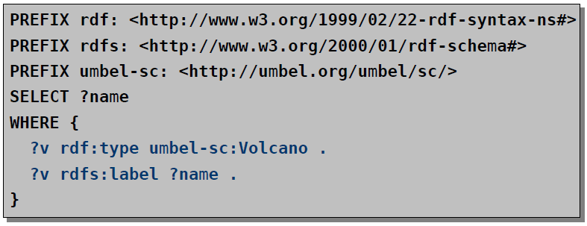
Basic Graph Patterns
Set of triple patterns (i.e. RDF triples with variables)
Variable names prefixed with “?” or “$” (e.g. ?v, $v)
Turtle syntax

Slide 15
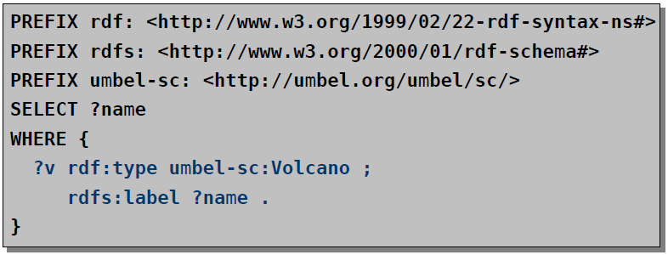
Basic Graph Patterns
Set of triple patterns (i.e. RDF triples with variables)
Variable names prefixed with “?” or “$” (e.g. ?v, $v)
Turtle syntax

Slide 16
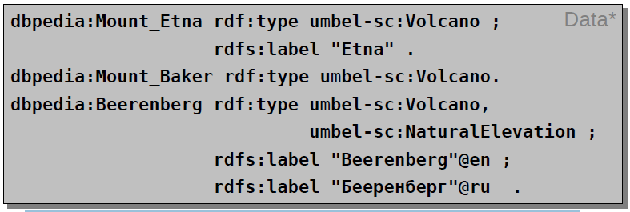
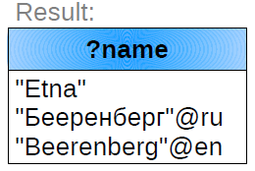
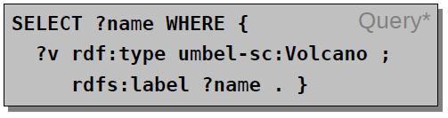
Basic Graph Patterns (Example)
Question: What are the names of all (known) volcanos?

Slide 17
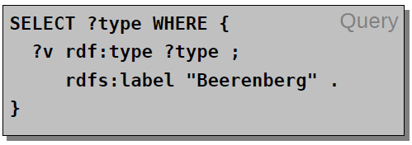
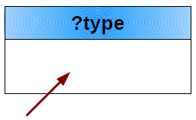
Basic Graph Patterns (Example)
Question: List all types of the volcano called “Beerenberg”

Slide 18
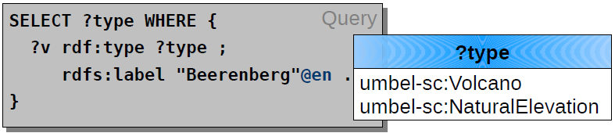
Basic Graph Patterns (Example)
Question: List all types of the volcano called “Beerenberg”

Slide 19
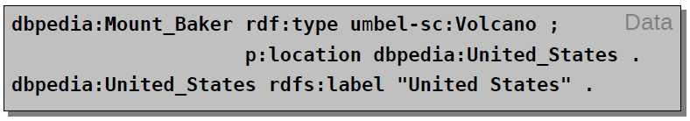
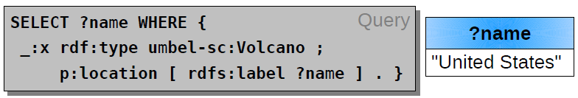
Basic Graph Patterns (Example)
Question: Where are all (known) volcanos located?
(List the names of these locations)
Blank nodes in SPARQL queries
As subject or object of a triple pattern

Slide 20
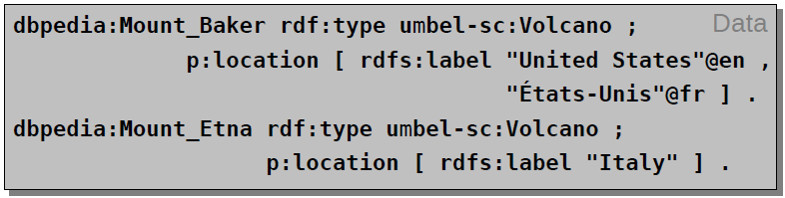
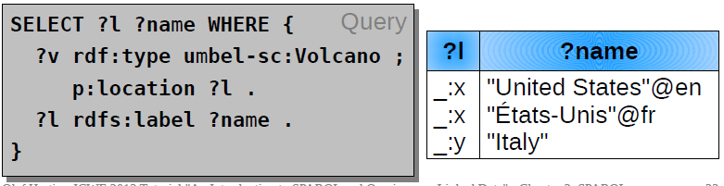
Basic Graph Patterns (Example)
Blank nodes in the queried data
Blank node identifiers may occur in the results

Slide 21
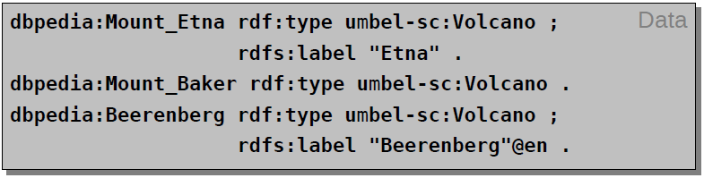
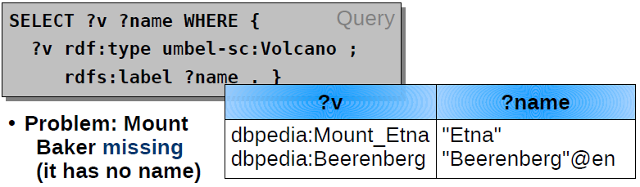
Optional Graph Patterns
Question: What are all (known) volcanos and their names?

Slide 22
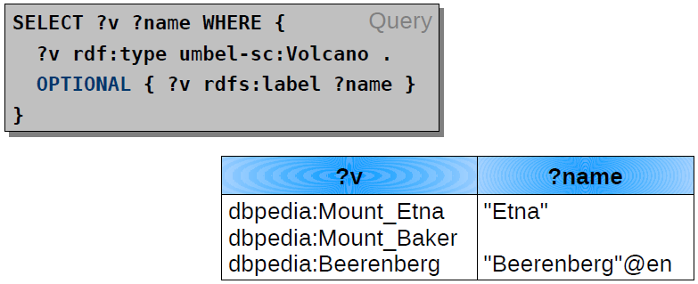
Optional Graph Patterns
Keyword OPTIONAL allows for optional patterns
Optional patterns may result in unbound variables

Slide 23
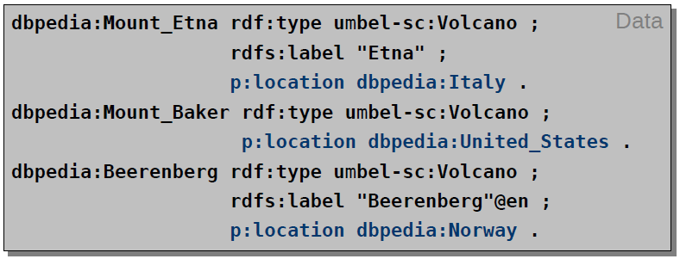
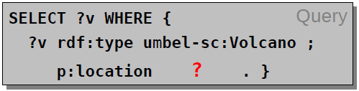
Union Graph Patterns
Question: What volcanos are located in Italy or in Norway?

Slide 24
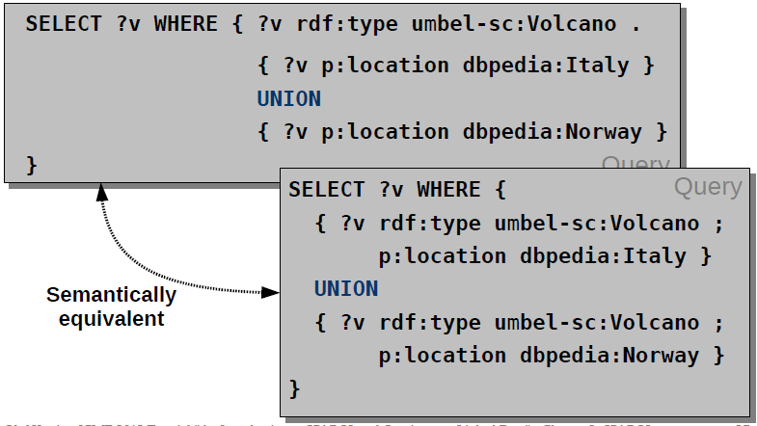
Union Graph Patterns
Union graph patterns allow for alternatives

Slide 25
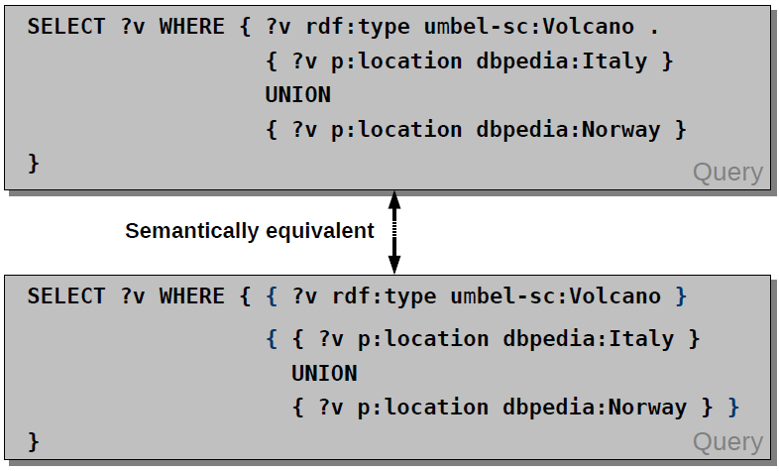
Group Graph Patterns

Slide 26
Practica 14

